Slide 1



Nitish Upreti
nzu100@cse.psu.edu

Slide 2
Goal : Solve Big Data !
How to achieve the best Performance ?

Slide 3


100 TB on 1000 machines
½ - 1 Hour
1 - 5 Minutes
1 second
?
Hard Disks
Memory

Slide 4


Better and Faster Frameworks ?
?
Evolved To
Evolves To

Slide 5
If we cannot do better than In-Memory than what?

Slide 6
Can we use Approximate Computing ?

Slide 7
Can you tolerate Errors ? Well, It depends on the scenario right…

Slide 8
Overview of Big Data Space

Slide 9
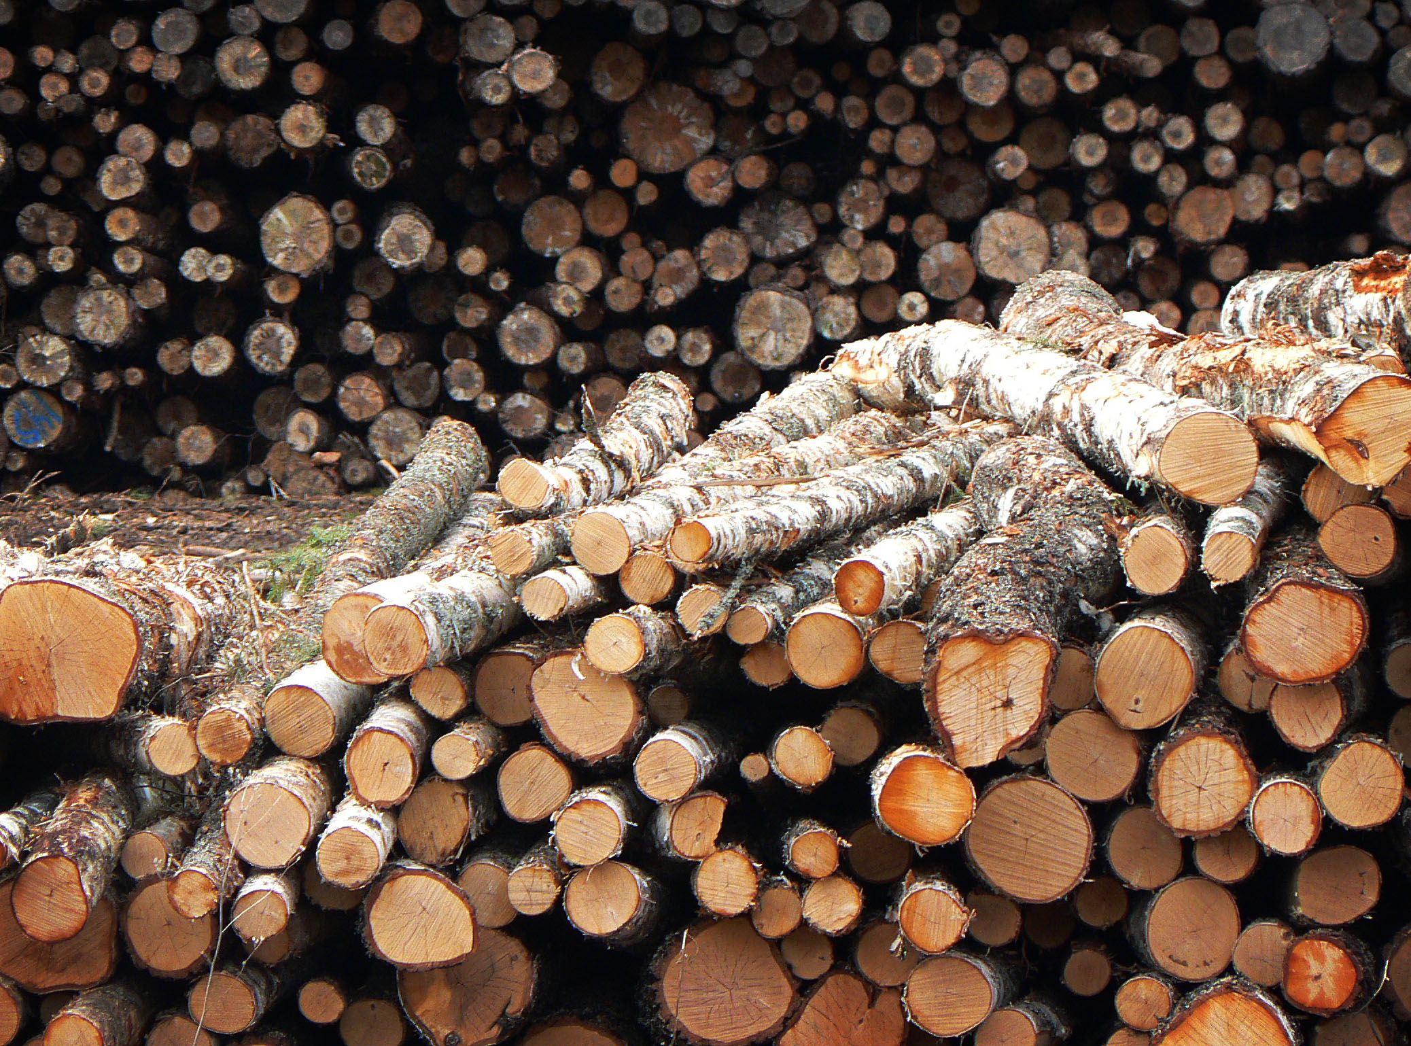
Massive log Batch processing

Slide 10
Can we use Approximate Computing ? Answer : YES / NO

Slide 11
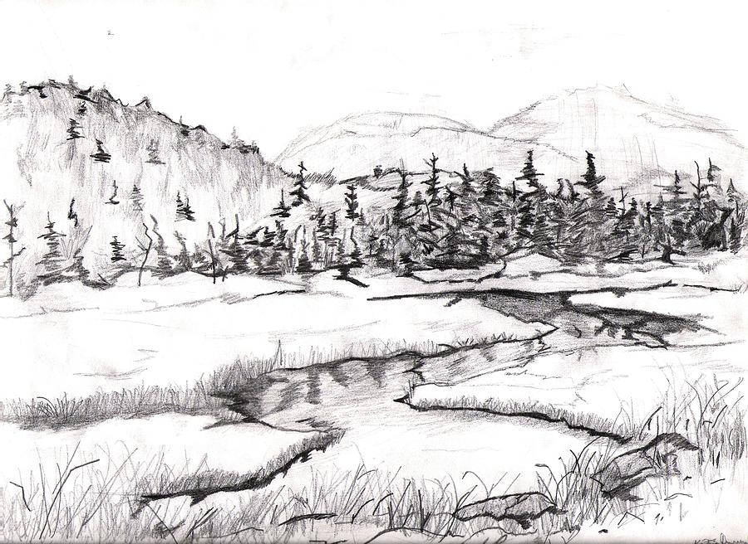
Streaming data processing

Slide 12
Can we use Approximate Computing ? Answer : MAYBE

Slide 13

Exploratory Data Analysis

Slide 14
Exploratory / Interactive Data Processing -- Getting a sense of data (Data Scientists) -- Debugging ? (SREs / DevOps)

Slide 15
Can we use Approximate Computing ? Answer : YES !

Slide 16
1) BlinkDB : Queries with Bounded Errors and bounded Response Times on Very Large Data.
2) Blink and It’s Done : Interactive Queries on Very Large Data.
3) A General Bootstrap Performance Diagnostic.
4) Knowing When You’re Wrong : Building Fast and Reliable Approximate Query Processing Systems.
Sameer Agrawal, Ariel Kleiner, Henry Milner, Barzan Mozafari, Ameet Talwalkar, Michael Jordan, Samuel Madden, Ion Stoica

Slide 17
Our Goal
Support interactive SQL-like aggregate queries over massive sets of data

Slide 18
Our Goal
Support interactive SQL-like aggregate queries over massive sets of data
blinkdb> SELECT AVG(jobtime)
FROM very_big_log
AVG, COUNT, SUM, STDEV, PERCENTILE etc.

Slide 19
Our Goal
Support interactive SQL-like aggregate queries over massive sets of data
blinkdb> SELECT AVG(jobtime)
FROM very_big_log
WHERE src = ‘hadoop’
FILTERS, GROUP BY clauses

Slide 20
Our Goal
Support interactive SQL-like aggregate queries over massive sets of data
blinkdb> SELECT AVG(jobtime)
FROM very_big_log
WHERE src = ‘hadoop’
LEFT OUTER JOIN logs2
ON very_big_log.id = logs.id
JOINS, Nested Queries etc.

Slide 21
Our Goal
Support interactive SQL-like aggregate queries over massive sets of data
blinkdb> SELECT my_function(jobtime)
FROM very_big_log
WHERE src = ‘hadoop’
LEFT OUTER JOIN logs2
ON very_big_log.id = logs.id
ML Primitives,
User Defined Functions
Notes:
The goal is to perform some aggregate analysis on this massive data.

Slide 22
Our Goal
Support interactive SQL-like aggregate queries over massive sets of data
blinkdb> SELECT my_function(jobtime)
FROM very_big_log
WHERE src = ‘hadoop’
ERROR WITHIN 10% AT CONFIDENCE 95%
Notes:
The goal is to perform some aggregate analysis on this massive data.

Slide 23
Our Goal
Support interactive SQL-like aggregate queries over massive sets of data
blinkdb> SELECT my_function(jobtime)
FROM very_big_log
WHERE src = ‘hadoop’
WITHIN 5 SECONDS
Notes:
The goal is to perform some aggregate analysis on this massive data.

Slide 24
Query Execution on Samples
ID | City | Buff Ratio
1 | NYC | 0.78
2 | NYC | 0.13
3 | Berkeley | 0.25
4 | NYC | 0.19
5 | NYC | 0.11
6 | Berkeley | 0.09
7 | NYC | 0.18
8 | NYC | 0.15
9 | Berkeley | 0.13
10 | Berkeley | 0.49
11 | NYC | 0.19
12 | Berkeley | 0.10
(Exploration Query)
What is the average buffering ratio in the table?
0.2325 (Precise)

Slide 25
Query Execution on Samples
ID | City | Buff Ratio
1 | NYC | 0.78
2 | NYC | 0.13
3 | Berkeley | 0.25
4 | NYC | 0.19
5 | NYC | 0.11
6 | Berkeley | 0.09
7 | NYC | 0.18
8 | NYC | 0.15
9 | Berkeley | 0.13
10 | Berkeley | 0.49
11 | NYC | 0.19
12 | Berkeley | 0.10
What is the average buffering ratio in the table?
ID | City | Buff Ratio | Sampling Rate
2 | NYC | 0.13 | 1/4
6 | Berkeley | 0.25 | 1/4
8 | NYC | 0.19 | 1/4
Uniform
Sample
0.2325 (Precise)
0.19

Slide 26
Query Execution on Samples
ID | City | Buff Ratio
1 | NYC | 0.78
2 | NYC | 0.13
3 | Berkeley | 0.25
4 | NYC | 0.19
5 | NYC | 0.11
6 | Berkeley | 0.09
7 | NYC | 0.18
8 | NYC | 0.15
9 | Berkeley | 0.13
10 | Berkeley | 0.49
11 | NYC | 0.19
12 | Berkeley | 0.10
What is the average buffering ratio in the table?
ID | City | Buff Ratio | Sampling Rate
2 | NYC | 0.13 | 1/4
6 | Berkeley | 0.25 | 1/4
8 | NYC | 0.19 | 1/4
Uniform
Sample
0.2325 (Precise)
0.19 +/- 0.05

Slide 27
Query Execution on Samples
ID | City | Buff Ratio
1 | NYC | 0.78
2 | NYC | 0.13
3 | Berkeley | 0.25
4 | NYC | 0.19
5 | NYC | 0.11
6 | Berkeley | 0.09
7 | NYC | 0.18
8 | NYC | 0.15
9 | Berkeley | 0.13
10 | Berkeley | 0.49
11 | NYC | 0.19
12 | Berkeley | 0.10
What is the average buffering ratio in the table?
ID | City | Buff Ratio | Sampling Rate
2 | NYC | 0.13 | 1/2
3 | Berkeley | 0.25 | 1/2
5 | NYC | 0.19 | 1/2
6 | Berkeley | 0.09 | 1/2
8 | NYC | 0.18 | 1/2
12 | Berkeley | 0.49 | 1/2
Uniform
Sample
0.2325 (Precise)
0.19 +/- 0.05
$0.22 +/- 0.02
Notes:
You can also control the size of the sample.

Slide 28
Speed/Accuracy Trade-off
Interactive
Queries
Error
Time to Execute on
Entire Dataset
2 sec
30 mins
Execution Time (Sample Size)

Slide 29
Speed/Accuracy Trade-off
Interactive
Queries
Error
Time to Execute on
Entire Dataset
Pre-Existing
Noise
2 sec
30 mins
Execution Time (Sample Size)
Notes:
Errors in the database : Issue with data collection. Measurement strategy.

Slide 30
Where do you want to be on the curve ?

Slide 31
Sampling Vs No Sampling on 100 Machines
1020
10x as response time
is dominated by I/O
Query Response Time (Seconds)
10²
18
13
10
8
1
10⁻¹
10⁻²
10⁻³
10⁻⁴
10⁻⁵
Fraction of full data (10TB)

Slide 32
Sampling Vs No Sampling
1020
Error Bars
Query Response Time (Seconds)
(0.02%)
103
(0.07%)
(1.1%)
(3.4%)
(11%)
18
13
10
8
1
10⁻¹
10⁻²
10⁻³
10⁻⁴
10⁻⁵
Fraction of full data

Slide 33
Okay, so you can tolerate errors… What are some of the fundamental challenges ? What types of Sample to create ? (cannot Sample everything) This boils to : What is our assumption on the nature of future query workload ?

Slide 34
Usual Assumption: Future queries are SIMILAR to past queries. What is Similarity ? ( Choosing the wrong notion has a heavy penalty : Under / Over fitting )

Slide 35
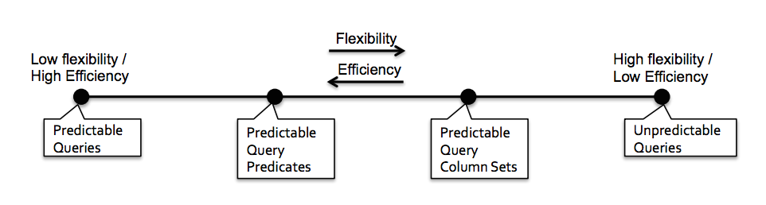
Workload Taxonomy

Slide 36
Predictable QCS
Fits well on the model of exploratory queries. (Queries are usually distinct but most will use the same column)
What kind of videos are popular for a region ?
Require looking at data from thousands of videos and hundreds of geographical regions. However fixed column sets : “video titles” (for grouping) and “viewer location” (for filtering).
Backed by empirical evidence from Conviva & Facebook. Key reason for BlinkDB efficiency. ( Lots of work in Database theory)

Slide 37
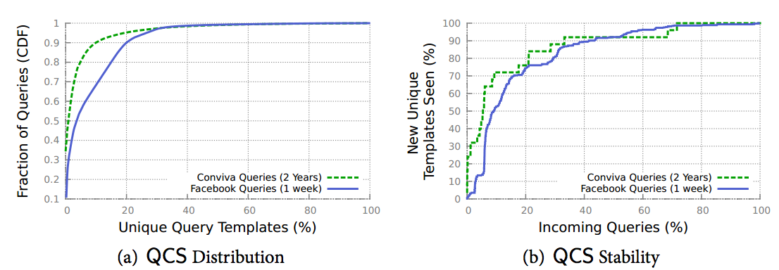

Slide 38
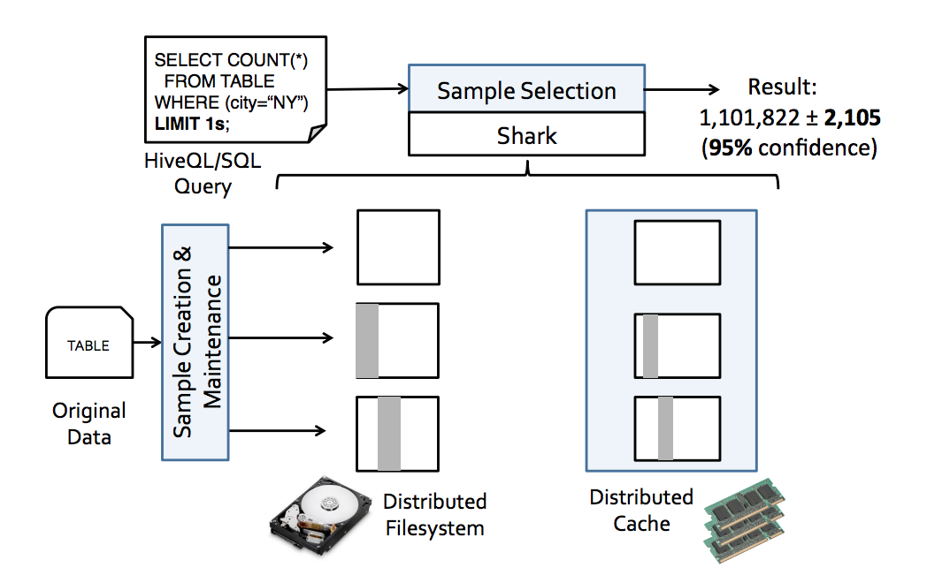
BlinkDB Overview

Slide 39
What is BlinkDB?
A framework built on Shark and Spark that …
Creates and maintains a variety of offline samples from underlying data.
Returns fast, approximate answers with error bars by executing queries on samples of data ( Runtime Error Latency Profile for Sample selection )
Verifies the correctness of the error bars that it returns at runtime.

Slide 40
1) Sample Creation

Slide 41
Building Samples for Queries
Uniform Sampling Vs Stratified Sampling.
Uniform sampling is however inefficient for queries that compute aggregates from group :
We could simply miss under-representing group.
We care about error of each query equally, with uniform sampling we would be assigning more samples to a group which is more represented.
Solution : Sample size assignment is deterministic and not random. This can be achieved with Stratified sampling.

Slide 42
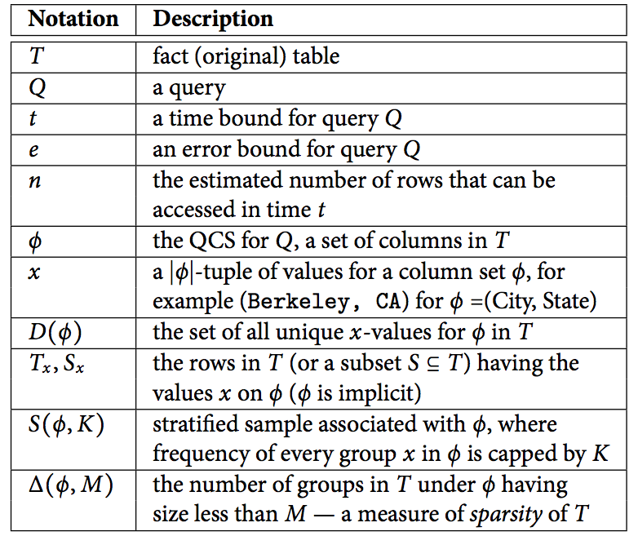
Some Terminology …

Slide 43
QCS to Sample On

Slide 44

What QCS to sample on ?
Formulation as an optimization problem, where three major factors to consider are : “sparsity” of data, “workload characteristics” and “storage cost of samples”.
Sparsity : Define a sparsity function as the number of groups whose size in ‘T’ is less than some number ‘M’.

Slide 45

QCS to sample (Contd)…
Workload : A query with QCS ‘q_{j}’ has some unknown probability ‘p_{j}’. The best estimate of p_{j} is past frequency of queries with QCS q_{j}.
Storage Cost : Assume a simple formulation where K is same for each group. For a set of columns in ϕ the storage cost is |S(ϕ,K)| :

Slide 46
Goal : Maximize the weighted sum of coverage. where ‘coverage’ for a query ‘q_{i}’ given a sample is defined as the probability that a given value ‘x’ for the columns is also present among the rows of S(ϕ_{i},K).

Slide 47
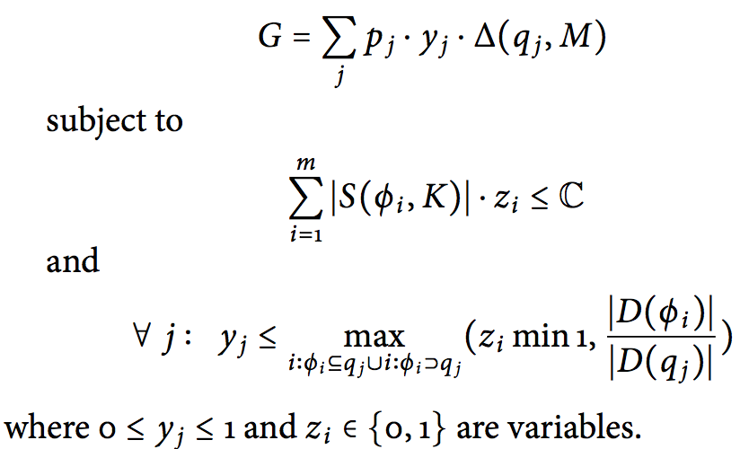
Optimization Problem Optimize the following MILP :
where ‘m’ are all possible QCS and ‘j’ indexes over all queries and ‘i’ over all column sets.

Slide 48
How to sample ?

Slide 49
Given a known QCS …
Compute Sample Count for a Group :
K = min ( n’ / D(ϕ) , |T x₀ | )
Take Samples as :
For each group, sample K rows uniformly at random without replacement forming sample S_{x}
The entire sample S(ϕ,K) is the disjoint union of multiple S_{x} :
If |T_{x}| > K, we answer based on K random tuples otherwise we can provide an exact answer.
For aggregate function AVG, SUM, COUNT and Quartile, K directly determines error .

Slide 50
Sharing QCS
Multiple queries with different ‘t’ and ‘n’ will share the same QCS. We need to select a subset from our sample dependency.
We need an appropriate storage technique to allow such subsets to be identified at runtime.

Slide 51
Storage Technique
The rows of stratified sample S(ϕ,K) are stored sequentially according to order of columns in ϕ.
When S_{x} is spread over multiple HDFS blocks, each block contains a random subset from S_{x} .
It is then enough to read any subset of blocks comprising S_{x} as long as these blocks contained minimum needed records.

Slide 52
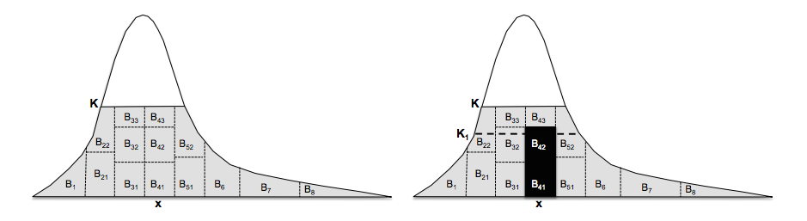
B_{ij} = Data Block (HDFS)

Slide 53
Storage Requirement
A table with 1 billion (10^12) tuples and a column set with a Zipf distribution (heavy tailed) with an exponent of 1.5, it turns out that the storage required by sample S(ϕ, K) is only 2.4% of the original table for K = 10^4, 5.2% for K = 10^5 , and 11.4% for K = 10^6. This is also consistent with real world data from Conviva & Facebook.

Slide 54
What is BlinkDB?
A framework built on Shark and Spark that …
creates and maintains a variety of samples from underlying data.
returns fast, approximate answers by executing queries on samples of data with error bars.
verifies the correctness of the error bars that it returns at runtime.

Slide 55
2) BlinkDB Runtime

Slide 56
Selecting a Sample
If BlinkDB finds one or more stratified samples on a set of columns ‘ϕ_{i}’ such that our query ‘q’ ⊆ ϕ_{i} , we pick the ϕ_{i} with smallest number of columns.
If no such QCS samples exist, run ‘q’ on in-memory subsets of all samples maintained by the system. Out of these, we select those with high selectivity.
Selectivity = Number of Rows Selected by q / Number of rows read by q

Slide 57
Selecting right Sample Size
Construct an ELP (Error Latency Profile) that characterizes the rate at which the error decreases ( and time increases) with increase in sample size by running query on smaller samples.
The scaling rate depends on query structure like JOINS, GROUP BY, Physical data placement and underlying data distribution.

Slide 58
Error Profile
Given Q’s error constraints : Idea is to predict the size of smallest sample that satisfies constraints.
Variance and Closed form aggregate functions are estimated using standard closed form formulas.
Also BlinkDB estimates query selectivity, input data distribution by running queries on smaller subsamples.
Number of rows are thus calculated using Statistical Error estimates.

Slide 59


Slide 60
Latency Profile
Given Q’s time constraints : Idea is to predict the maximum size sample that we should run query on within the constraints.
Value of ‘n’ depends on input data, physical placement of disk, query structure and available resources. So as a simplification : BlinkDB simply predicts ‘n’ by assuming latency scales linearly in input size.
For very small in-memory samples : BlinkDB runs a few smaller samples until performance seems to grow linearly and then estimate the linear scaling constants.

Slide 61
Correcting Bias
Running a query on a non-uniform sample introduces certain amount of statistical bias and introduce subtle inaccuracies.
Solution : BlinkDB periodically replaces the samples use using a low priority background task which periodically ( daily ) samples the original data which are then used by the system.

Slide 62
Error Estimation
Closed Form Aggregate Functions
Central Limit Theorem
Applicable to AVG, COUNT, SUM, VARIANCE and STDEV
Notes:
What about error estimates where there is no aggregate function?

Slide 63
Error Estimation
Closed Form Aggregate Functions
Central Limit Theorem
Applicable to AVG, COUNT, SUM, VARIANCE and STDEV
Generalized Aggregate Functions
Statistical Bootstrap
Applicable to complex and nested queries, UDFs, joins etc.
Very computationally expensive.

Slide 64
But we are not done yet …
Statistical functions like CLT and Bootstrap operate under a set of assumption on query / data.
We need to have some correctness verifiers !

Slide 65
What is BlinkDB?
A framework built on Shark and Spark that …
creates and maintains a variety of samples from underlying data
returns fast, approximate answers with error bars by executing queries on samples of data
verifies the correctness of the error bars that it returns at runtime

Slide 66

Kleiner’s Diagnostics
More Data → Higher Accuracy
300 Data Points → 97% Accuracy
Error
[KDD 13]
Sample Size

Slide 67
300 Data Points ≈ 30K Queries for Bootstrap !

Slide 68
So In an Approximate QP :
One query that estimates the answer.
Hundred Queries on Resample of data that computes the error.
Tens of Thousand of Queries to verify if this error is correct.
BAD PERFORMANCE !
Solution: Single Pass Execution framework.

Slide 69
What is BlinkDB?
A framework built on Shark and Spark that …
creates and maintains a variety of samples from underlying data
returns fast, approximate answers with error bars by executing queries on samples of data
verifies the correctness of the error bars that it returns at runtime

Slide 70
BlinkDB Implementation

Slide 71
BlinkDB Architecture
Command-line Shell
Thrift/JDBC
Meta
store
Driver
SQL Parser
Query Optimizer
Physical Plan
UDFs
Execution
Hadoop/Spark/Presto
Hadoop Storage (e.g., HDFS, Hbase, Presto)

Slide 72
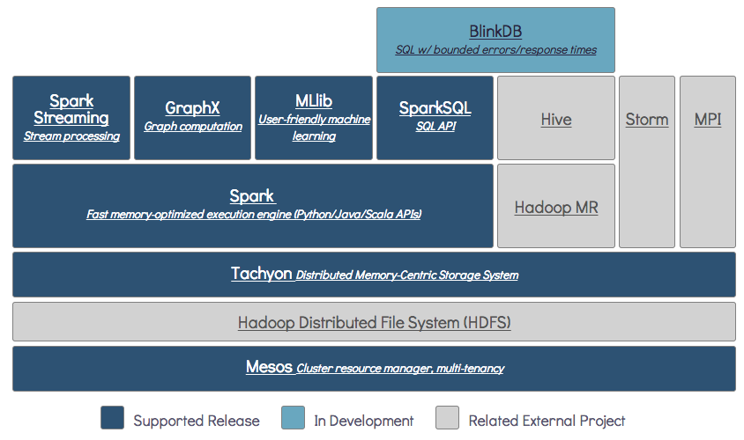

Slide 73
Implementation Changes
Additions in Query Language Parser.
Parser can trigger a sample creation and maintenance module.
A sample selection module that re-writes the query and assigns it an approximately sized sample.
Uncertainty module to modify all pre-existing aggregation function to return error bars and confidence intervals.
A module periodically samples from the original data, creating new samples which are then used by the system. (Co-Relation + Workload Changes)

Slide 74
BlinkDB Evaluation

Slide 75
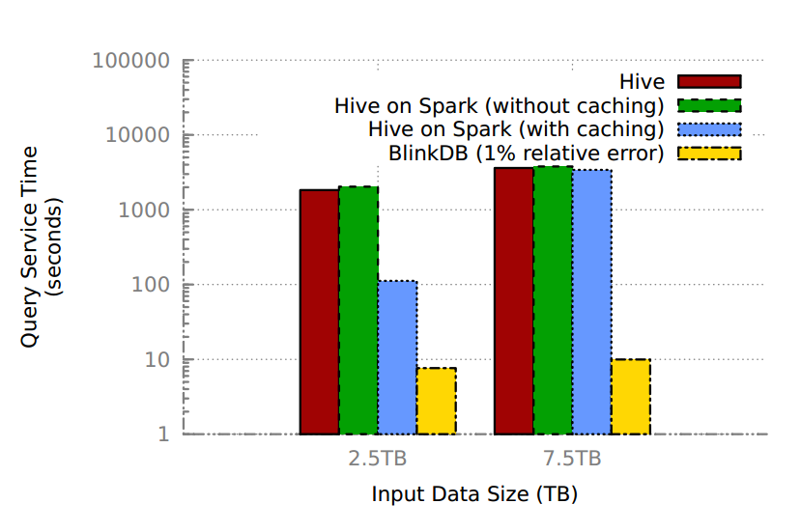
BlinkDB Vs. No Sampling
2.5 TB from Cache
7.5 TB from Disk
Log Scale

Slide 76
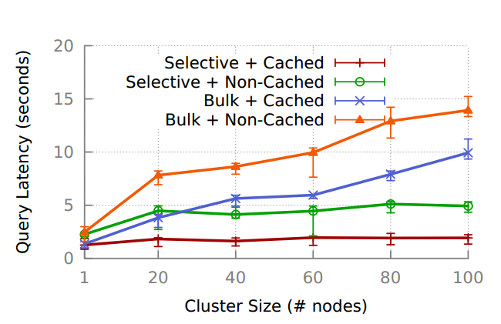
Scaling BlinkDB
Each query operates on 100N GB of data.

Slide 77
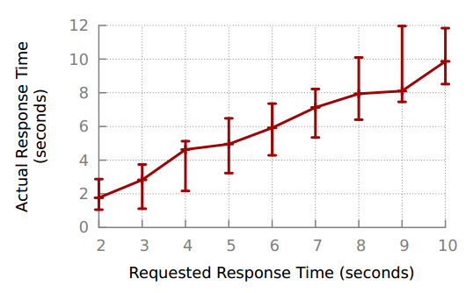
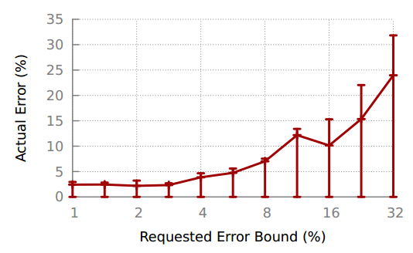
Response Time and Error Bounds …
20 Conviva queries averaged over 10runs

Slide 78
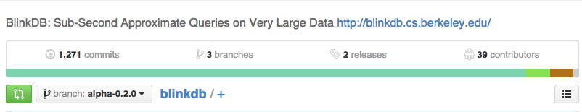
Play with BlinkDB! https://github.com/sameeragarwal/blinkdb

Slide 79
Take Away …
The only way for now to escape memory performance barrier is to use Approximate Computing .
A huge role to play in exploratory data analysis.
BlinkDB provides a framework for AQP + Error Bars + Verifies them.
Great Performance on real world workloads.

Slide 80
Personal Takeaway : Take a STATISTICS class!

Slide 81
Credits
These slides are derived from Sameer Agarwal’s presentation : http://goo.gl/cvVb1X

Slide 82
Questions ? THANK YOU!

